Slide 1
HOMEWORK 7 Due 5/23 00:00 send to e3

Slide 2
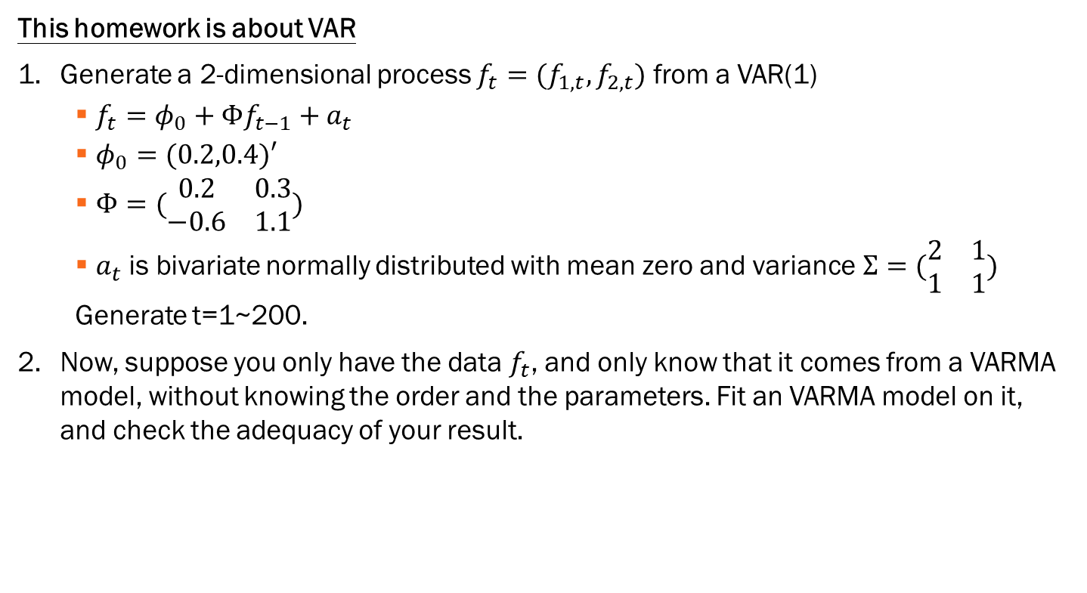
This homework is about VAR
Generate a 2-dimensional process ${f_{t}=(f}_{1,t}, f_{2,t})$ from a VAR(1)
$f_{t}=φ_{0}+Φf_{t−1}+a_{t}$
$φ_{0}=(0.2,0.4)′$
$Φ=(\begin{matrix}0.2 & 0.3 \\ −0.6 & 1.1\end{matrix})$
$a_{t}$ is bivariate normally distributed with mean zero and variance$Σ=(\begin{matrix}2 & 1 \\ 1 & 1\end{matrix})$
Generate t=1~200.
Now, suppose you only have the data $f_{t}$, and only know that it comes from a VARMA model, without knowing the order and the parameters. Fit an VARMA model on it, and check the adequacy of your result.

